Slide 1

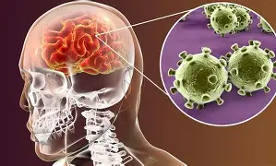

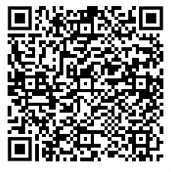


Information for Young People
Meningitis Outbreak in the UK
There is a current outbreak of meningitis in the South of England, mainly affecting young people in sixth forms and universities. Sadly, two preventable deaths have already been reported, and 11 other young people are currently seriously ill in hospital.
Meningitis can come on very suddenly and get worse quickly. The symptoms aren’t the same for everyone, and not all symptoms appear at once.
The best way to protect yourself is to make sure you’ve had the meningitis vaccine. If you’re not sure whether you’ve been vaccinated, please contact us — we can check for you and help you stay protected.
Please scan the QR code for further information on the vaccines.
NHSimmunisations-reading@berkshire.nhs.uk
0300 365 0077(Mon to Fri 9am – 4pm)

