Slide 1
Individual Learning/Learner Plans (ILPS)

Slide 2
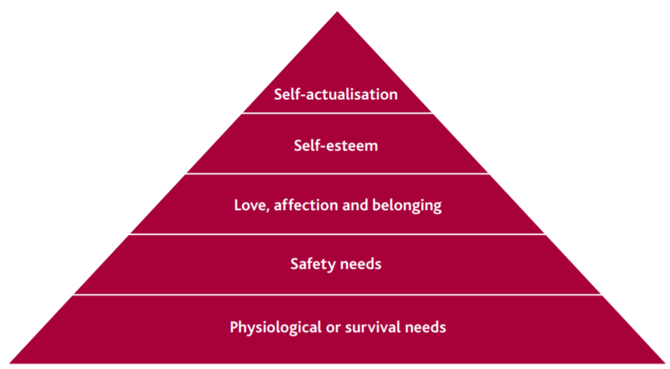
How can we relate Maslow's Hierarchy of Needs to supporting individual needs?
Maslow never put his work in a pyramid!
Maslow’s theory can be helpful for teachers and support staff working in education in making sure that students are able to learn by understanding and attending to the wider range of needs that they have.
The needs that Maslow outlines can be met in different environments.
A student might not be able to have all their needs met equally at home, at college, and in the community – but if at least one of these environments meets the need, the student will have a greater chance of progressing towards ‘self-actualisation’.
Individual Learning plans are written and used to identify learner needs and outline support mechanisms put in place to reduce barriers to education.

Slide 3
What might you find on an ISP/ILP?

Slide 4
An ISP/ILP might include...
The nature of the child or young person’s learning or developmental difficulties
What help should be given
Who will give the help; what equipment, programmes or materials will be used
When, where and how often the help will be given
The nature of the support required from parents at home
Any pastoral care or medical requirements
The monitoring and review arrangements
How it will be decided if the help has been successful (you may see the phrase 'success criteria')
Find out more at individual education plans (autism.org.uk)

