Slide 1

Session 4: Feedback

Slide 2
Why is this poor practice?
Good
Style!
Disorganised
This just won’t do
You appear to be unable to distinguish between that which is given and that to be proven.
Well done
I am proud of you!

Slide 3
Do you think these are better? WHY?
Well done, that’s a good way to solve that problem
That’s really excellent. The presentation of the data is crystal clear
Good, all the commas are in exactly the right place
The meaning is not very clear here. I find what it appears to mean very unlikely, can you quote the figures?
This middle sentence is not related clearly to the other two
Important point but needs broadening out from specific examples
Yes, it is very difficult to assess the effectiveness of the Labour Party in this role. I would have welcomed an example on a local issue known to you.

Slide 4
EBI – Even BETTER IF! We use FEEDFORWARD
Avoid negative comments that will shut the learners off from moving forward.
Plan next time to include more examples
Add a further explanation to show the differences in approaches
Research so that you include more resources
Experiment with a larger range of colour combinations
Check your spellings of the keywords
Further information here: https://www.cultofpedagogy.com/feedforward/

Slide 5
Focus YOUR feedback on what you want to improve
What’s the point?
Offering feedback on the process and not the individual’s character will often allow students to create more positive attitudes towards taking on new challenges (Brock and Hundley, 2016).
Lessons are seen as safe spaces to make mistakes as that is how we move forward and become successful.

Slide 6
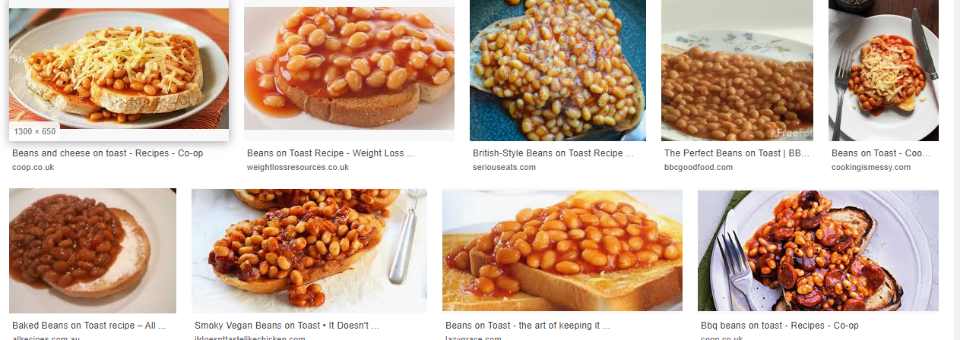
Can you create feedback for one of these?
1
2
3
4
5
6
7
8
9

Slide 7
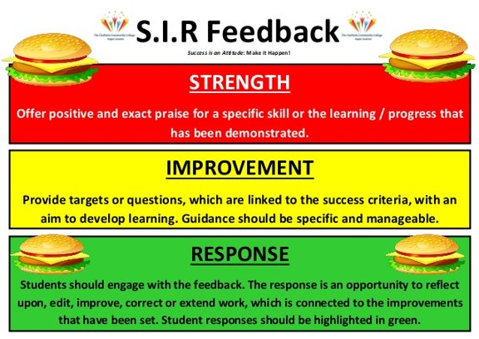
Discussion on feedback using the SIR method
STRENGHTS
IMPROVEMENTS
RESPONSE

Slide 8
Summing up
What is the takeaway from this session?
  Easy takeaway – like a MacDonald's (other fast food outlets are available) = Pick up and go!
  Medium takeaway – like a sit-down curry (other cultural food options available) = More thought needed
  Hard takeaway – like a food hall when you have to think about the choice on offer = Will go research it!
https://twitter.com/teacherhead/status/1497541387050491906?t=6L5VJ8IMEUjUh6s-CM36kQ&s=09

