Slide 1
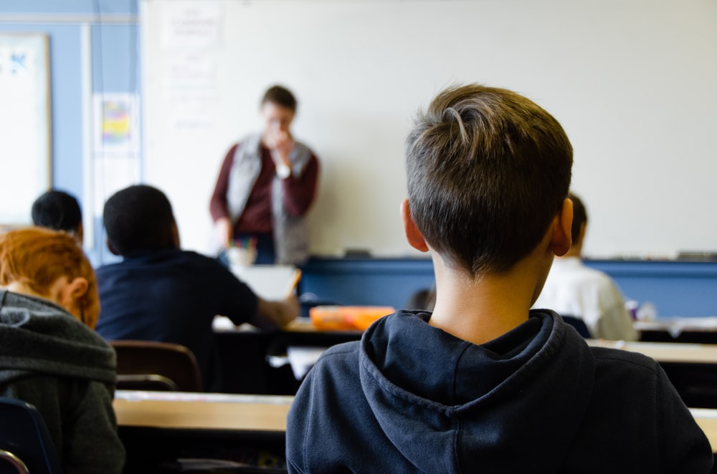
Effective Classroom Management Strategies
.

Slide 2
The FE Learner
Social and cultural barriers | Peer pressure and family background
Practical and personal barriers | Transport; time; disability; caring responsibilities; childcare; finance; language; and lack of access to information
Emotional barriers | Lack of self-esteem, low confidence, negative personal experience of learning; previously undetected or unaddressed learning disabilities; social problems such as abuse or bullying
Other barriers | Absence; lack of technology; lack of support; shift work; isolation

Slide 3
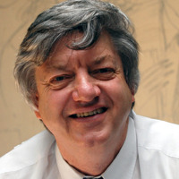
Bill Rogers: Behaviour Management Strategies
Dr Bill Rogers taught for many years before becoming an education consultant and author; he lectures widely on behaviour management, discipline, effective teaching, stress management and teacher welfare across the UK and Europe, Australia and New Zealand.
Bill also works as a mentor-teacher, team-teaching in challenging schools. He is well aware of the challenges of teacher leadership in schools today.
Learn more about Bill and his journey into teaching and behaviour management in his piece:
'I never thought I'd become a teacher!'

Slide 4
Dr Bill Rogers - Introduction

Slide 5
Dr Bill Rogers – Ensuring a settled and focused class

Slide 6
Dr Bill Rogers - Dealing with distractions confidently

Slide 7
Dr Bill Rogers - Students who just say "NO"

Slide 8
Dr Bill Rogers - Cracking the Challenging Class

Slide 11
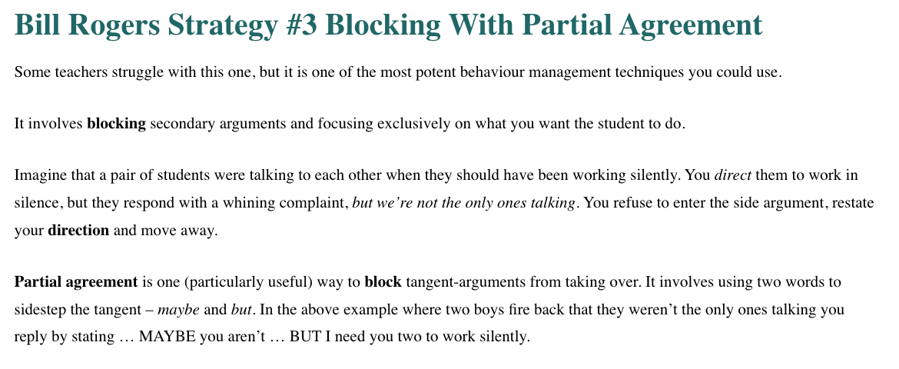

Slide 14
