Slide 1
Session 1: Mental Health for Teachers

Slide 2
Learning Outcomes
Explore the importance of teacher wellbeing
Identify some useful strategies for improving our own mental health

Slide 4
Prioritising Workload
12 Smart Steps to Reduce Teacher Workload (teachertoolkit.co.uk)

Slide 5
47 Wellbeing Tips For Teachers | Teacher Toolkit

Slide 6
47 Wellbeing Tips For Teachers | Teacher Toolkit

Slide 7
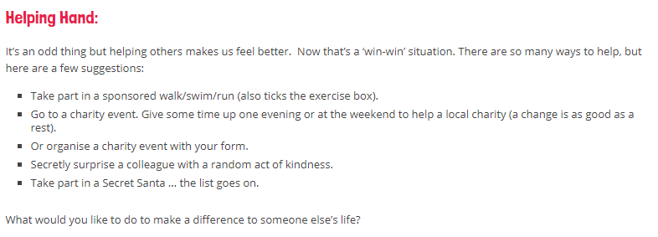
47 Wellbeing Tips For Teachers | Teacher Toolkit

Slide 8
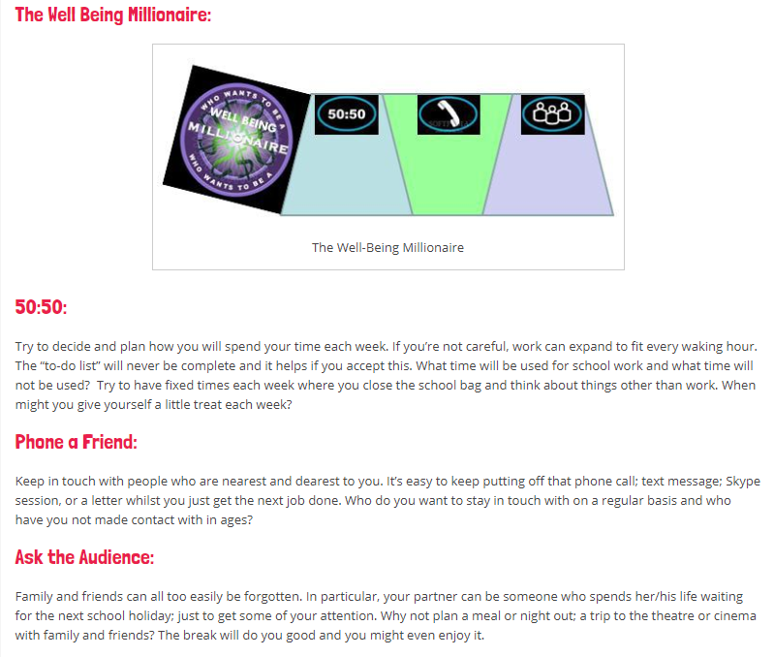
47 Wellbeing Tips For Teachers | Teacher Toolkit

Slide 9
Reflection

